Slide 1
Some Theoretical Aspects of Road Traffic Rearch
John Glen Wardop, B.A

Slide 2
CONTENTS
Flow and speed of traffic
Frequency of overtaking
Capacity of road system
Signal-controlled intersections
Formation of queues

Slide 3
1. Flow and speed of traffic
Distribution of Speed in Time
Distributon of Speed in Space
Mean Speeds
Speed versus Journey Time

Slide 4
Distribution of Speed in time
Flow
Series of events random in time
Series of events random in space
Theoretical model of traffic

Slide 5
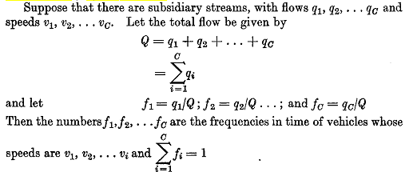
Distribution of Speed in time

Slide 6
1. Flow and speed of traffic
Distribution of Speed in Time
Distributon of Speed in Space
Mean Speeds
Speed versus Journey Time

Slide 7
Distributon of Speed in Space

Slide 8
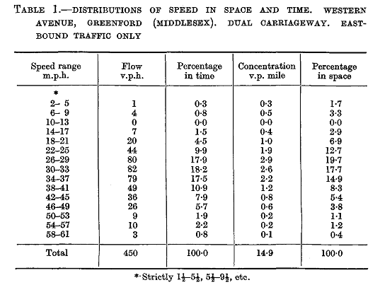

Slide 9
Flow and speed of traffic
Distribution of Speed in Time
Distributon of Speed in Space
Mean Speeds
Speed versus Journey Time

Slide 10
Mean Speeds

Slide 11
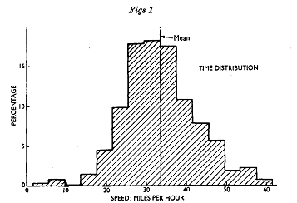
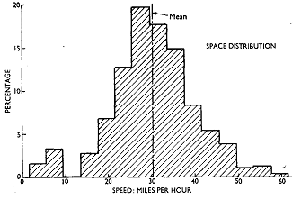
Mean Speeds

Slide 12
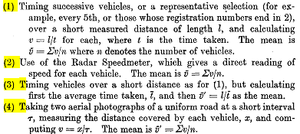
Mean Speeds

Slide 13
Mean Speeds

Slide 14
Flow and speed of traffic
Distribution of Speed in Time

Slide 15
Flow and speed of traffic
Distribution of Speed in Time
Distributon of Speed in Space
Mean Speeds
Speed versus Journey Time

Slide 16
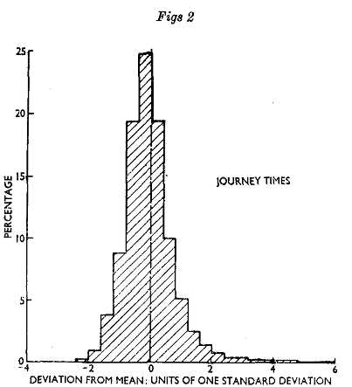
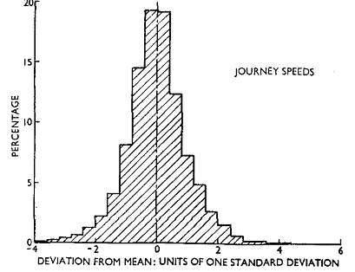
Speed versus Journey Time

Slide 17
Speed versus Journey Time

Slide 18
CONTENTS
Flow and speed of traffic
Frequency of overtaking
Capacity of road system
Signal-controlled intersections
Formation of queues

Slide 19
2. FREQUENCY OF OVERTAKING
Consinder: v_{i}
Interval pass
Frequency of overtaking

Slide 20
FREQUENCY OF OVERTAKING

Slide 21
CONTENTS
Flow and speed of traffic
Frequency of overtaking
Capacity of road system
Signal-controlled intersections
Formation of queues

Slide 22
CAPACITY OF ROAD SYSTEM

Slide 23
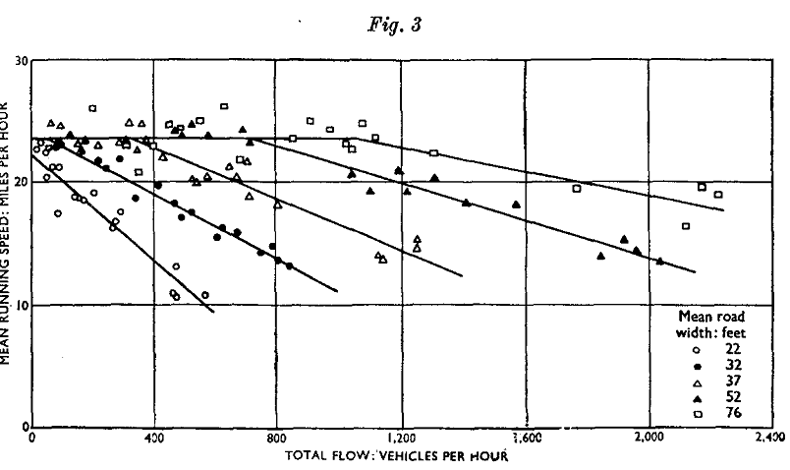
3. CAPACITY OF ROAD SYSTEM

Slide 24
3. CAPACITY OF ROAD SYSTEM
It is more appropriate to regard the speed
as a function of the flow than vice versa.

Slide 25
3. CAPACITY OF ROAD SYSTEM

Slide 26
CONTENTS
Flow and speed of traffic
Frequency of overtaking
Capacity of road system
Signal-controlled intersections
Formation of queues

Slide 27
SIGNAL-CONTROLLED INTERSECTIONS
1
Optimum Phase Times for a Two-Phase Fixed-Time Signal
2
Vehicle-Actuated Signals
3
The Effect of Randomness of Traffics on Intersection Delay

Slide 28
SIGNAL-CONTROLLED INTERSECTIONS

Slide 29
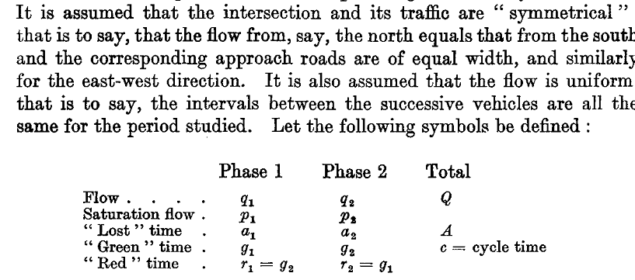
SIGNAL-CONTROLLED INTERSECTIONS

Slide 30
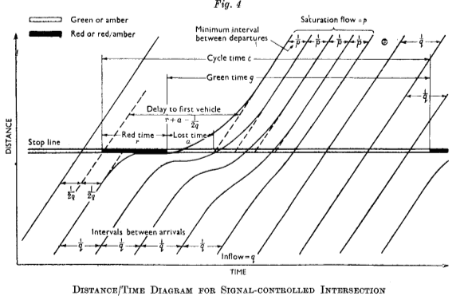
SIGNAL-CONTROLLED INTERSECTIONS

Slide 31
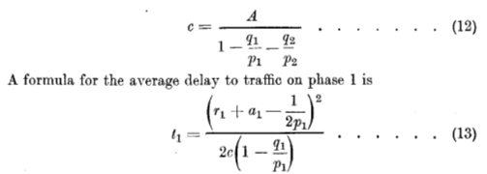
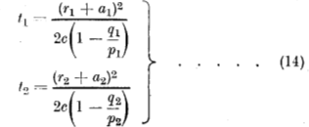
SIGNAL-CONTROLLED INTERSECTIONS

Slide 32
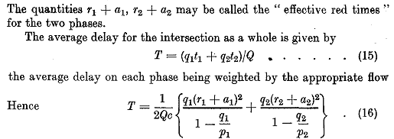
SIGNAL-CONTROLLED INTERSECTIONS

Slide 33
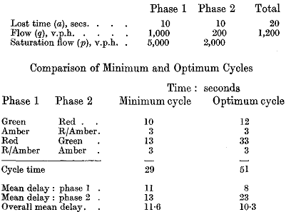
SIGNAL-CONTROLLED INTERSECTIONS

Slide 34
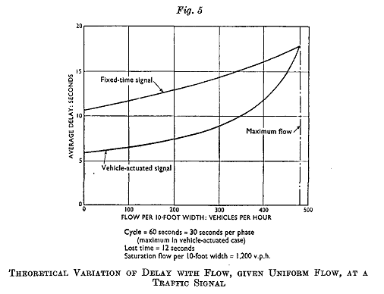
SIGNAL-CONTROLLED INTERSECTIONS

Slide 35
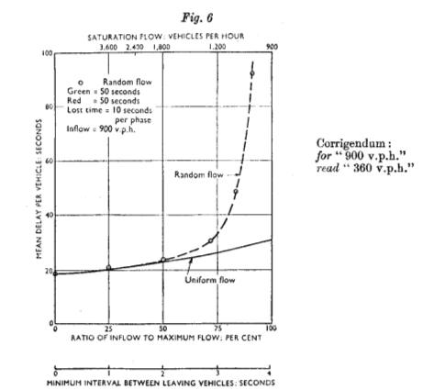
SIGNAL-CONTROLLED INTERSECTIONS

Slide 36
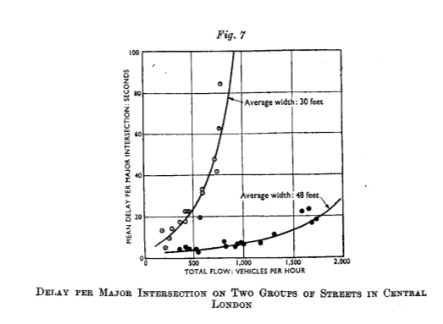
SIGNAL-CONTROLLED INTERSECTIONS

Slide 37
CONTENTS
Flow and speed of traffic
Frequency of overtaking
Capacity of road system
Signal-controlled intersections
Formation of queues

Slide 38
FORMATION OF QUEUES

Slide 39
FORMATION OF QUEUES

Slide 40
FORMATION OF QUEUES

Slide 41
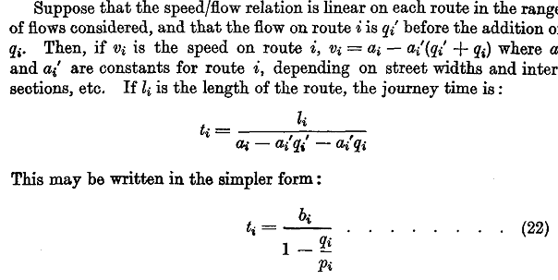
FORMATION OF QUEUES

Slide 42
FORMATION OF QUEUES

Slide 43
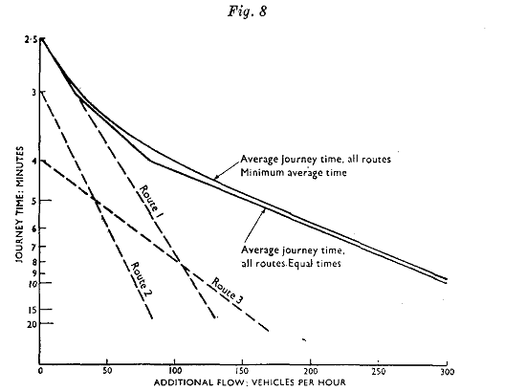
FORMATION OF QUEUES

