Slide 1
USER EQUILIBRIUM WITH DEMAND VARIABLE

Slide 2
OBJECTIVES
Equivalent Minimization Formulation
Solution Algorithm
Solution by Network Representation

Slide 3
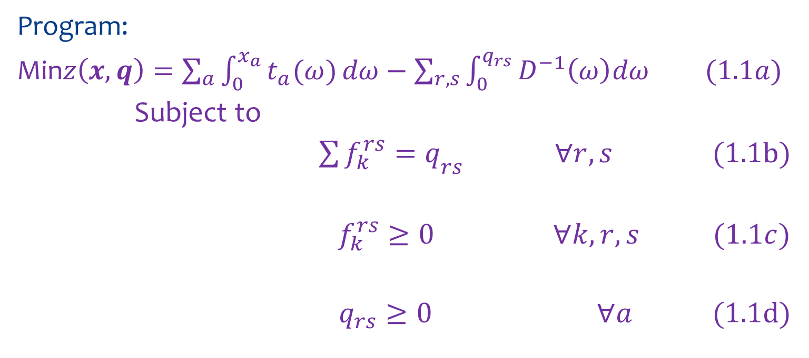
EQUIVALENT MINIMIZATION FORMULATION
Program:
Min$z\left(x,q\right)=\sum_{a}{\int_{0}^{x_{a}}{t_{a}(ω)}}dω−\sum_{r,s}{\int_{0}^{q_{rs}}{D^{−1}\left(ω\right)dω}} (1.1a)$
Subject to
${\sum{f_{k}^{rs}=q}}_{rs} ∀r,s$ (1.1b)
$f_{k}^{rs}≥0 ∀k,r,s (1.1c)$
$q_{rs}≥0 ∀a$ (1.1d)

Slide 4
EQUIVALENCE CONDITIONS
The first-order conditions:
$$f_{k}^{rs}\left(c_{k}^{rs}−u_{rs}\right)=0$$
$${ c}_{k}^{rs}−u_{rs}≥0$$
$q_{rs}\left[u_{rs}−D^{−1}\left(q_{rs}\right)\right]=0$
$$u_{rs}−D^{−1}\left(q_{rs}\right)≥0$$
$$q_{rs}−\sum_{k}{f_{k}^{rs}=0}$$
$$f_{k}^{rs}≥0$$
$${ q}_{rs}≥0$$

Slide 5
UNIQUENESS CONDITIONS
Consider two functions:
$$z_{1}\left(x\right)=\sum_{a}{\int_{0}^{x_{a}}{t_{a}\left(ω\right)dω}}$$
$$z_{2}\left(x\right)=−\sum_{rs}{\int_{0}^{q_{rs}}{D^{−1}\left(ω\right)dω}}$$
They are strictly convex $⇒$uniqueness solution.

Slide 6

SOLUTION ALGORITHM
Problem:
Min$z\left(x,q\right)=\sum_{a}{\int_{0}^{x_{a}}{t_{a}(ω)}}dω−\sum_{r,s}{\int_{0}^{q_{rs}}{D^{−1}\left(ω\right)dω}} (2.1a)$
Subject to
${\sum{f_{k}^{rs}=q}}_{rs} ∀r,s$ (2.1b)
$f_{k}^{rs}≥0 ∀k,r,s (2.1c)$
$q_{rs}≤\overline{q_{rs}} ∀a$ (2.1d)

Slide 7
Using convex combination algorithm:
Step $0$: Find an initial flow pattern: $\left\{x_{a}^{1}\right\}, \left\{q_{rs}^{1}\right\}.$Set $n=1$
Step $1$: Update
$t_{a}^{n}=t_{a}\left(x_{a}^{n}\right) ∀a.$ Compute $D^{−1}\left(q_{rs}\right) ∀r,s.$
Step $2$: Direction finding
For each O-D pair $r−s$, compute the shortest path m .
If: $c_{m}^{rs,n}<D^{−1}\left(q_{rs}^{n}\right),set g_{m}^{rs,n}=\overline{q_{rs}} and$
$$g_{k}^{rs,n}= 0 ∀k≠m$$
If : $c_{m}^{rs,n}<D^{−1}\left(q_{rs}^{n}\right),set g_{m}^{rs,n}=0 ∀k$

Slide 8

$$y_{a}^{n}=\sum_{r,s,k}{g_{k}^{rs,n}}δ_{a,k}^{rs}$$
$θ_{rs}^{n}=\sum_{k}{g_{k}^{rs,n}}$
Set: $d^{n}=\left(y_{a}^{n}−x_{a}^{n}\right),…(θ_{rs}^{n}−q_{rs}^{n})$

Slide 9
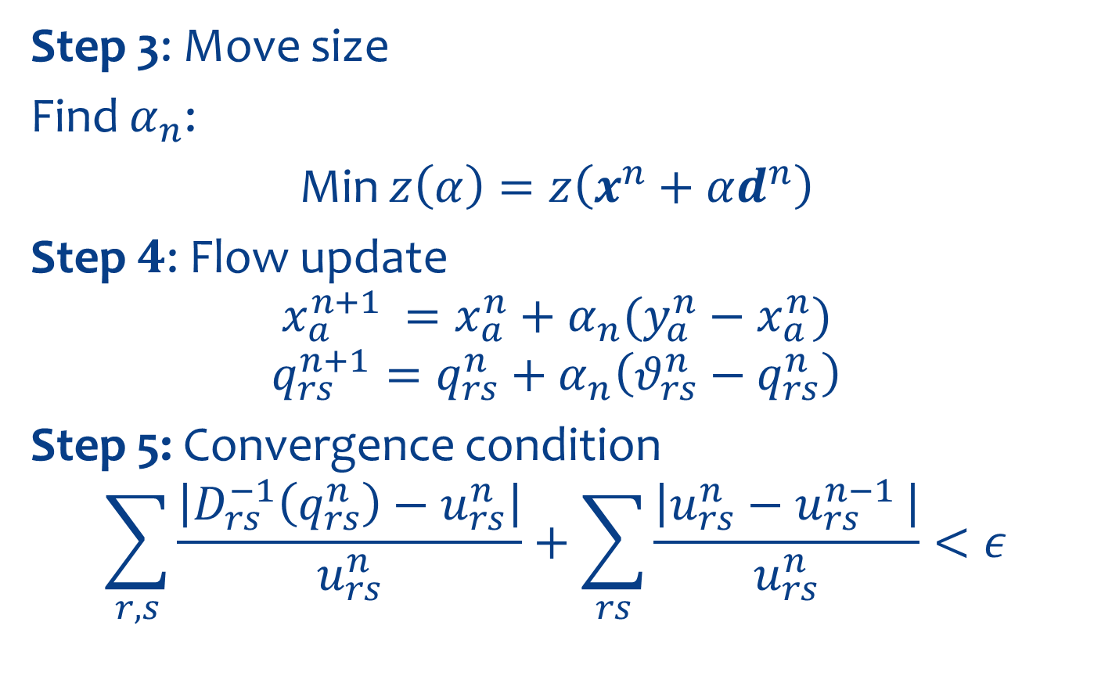
Step 3: Move size
Find $α_{n}$:
Min $z\left(α\right)=z\left(x^{n}+αd^{n}\right)$
Step $4$: Flow update
$$x_{a}^{n+1 }=x_{a}^{n}+α_{n}(y_{a}^{n}−x_{a}^{n})$$
$$q_{rs}^{n+1}=q_{rs}^{n}+α_{n}\left(θ_{rs}^{n}−q_{rs}^{n}\right)$$
Step 5: Convergence condition
$$\sum_{r,s}{\frac{\left|D_{rs}^{−1}\left(q_{rs}^{n}\right)−u_{rs}^{n}\right|}{u_{rs}^{n}}+\sum_{rs}{\frac{\left|u_{rs}^{n}−u_{rs}^{n−1 }\right|}{u_{rs}^{n}}}}<ε$$

Slide 10
SOLUTION BY NETWORK REPRESENTATION

Slide 11
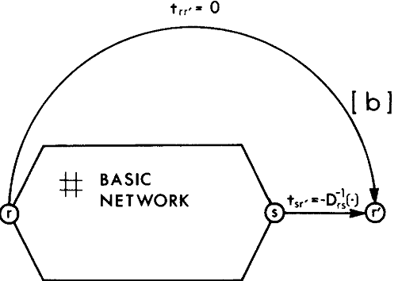
THE ZERO COST OVER FLOW FORMULATION

Slide 12
Added node $r′$ into basic network$⇒$ modified network
$$t_{sr′}=−D^{−1}\left(.\right) and t_{rr^{′}}^{}=0 ∀r,s.$$

Slide 13

Formulation:
Min $z\left(x\right)=\sum_{a}{\int_{0}^{x_{a}}{t_{a}\left(ω\right)dω+}}\sum_{rs}{\int_{0}^{x_{rs′}}{t_{sr′}\left(ω\right)dω+}}$
$$\sum_{rs}{\int_{0}^{x_{rr′}}{t_{rr′}\left(ω\right)dω}} (2.1a)$$
Subject to:
$$\sum_{rs}{f_{k}^{rs}+x_{rr′}=}q_{rs} ∀ r,s (2.1b)$$
$$f_{kr}^{rs}≥0 ∀ k,r,s (2.1c)$$
$$x_{rr′}≥0 ∀r,r^{′} (2.1d)$$

Slide 14
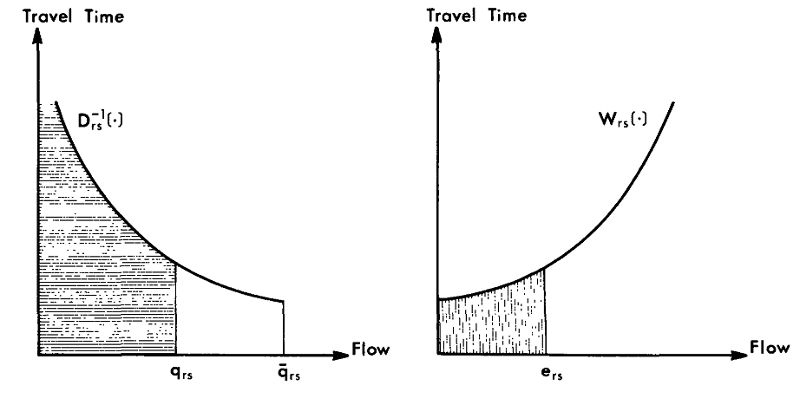

EXCESS – DEMAND FORMULATION
Let: $e_{rs}=\overline{q_{rs}}−q_{rs}$
$$W_{rs}\left(.\right): W_{rs}\left(e_{rs}\right)=D^{−1}(q_{rs})$$

Slide 15
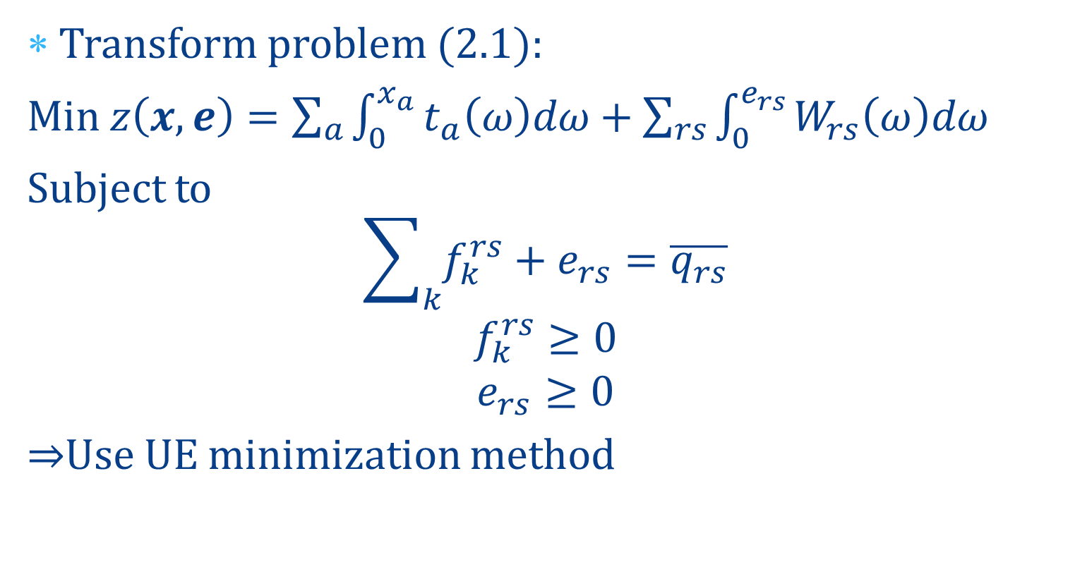
Transform problem (2.1):
Min $z\left(x,e\right)=\sum_{a}{\int_{0}^{x_{a}}{t_{a}\left(ω\right)dω}}+\sum_{rs}{\int_{0}^{e_{rs}}{W_{rs}\left(ω\right)dω}}$
Subject to
$$\sum_{k}{f_{k}^{rs}}+e_{rs}=\overline{q_{rs}}$$
$$f_{k}^{rs}≥0$$
$$e_{rs}≥0$$
$⇒$Use UE minimization method

