Slide 1
Road engineering division meeting
Some Theoretical Aspects of Road Traffic Rearch
John Glen Wardop, B.A

Slide 2
category
Flow and speed of traffic
Frequency of overtaking
Capacity of road system
Signal-controlled intersections
Formation of queues

Slide 3
Flow and speed of traffic
Distribution of Speed in Time
Distributon of Speed in Space
Mean Speeds
Speed versus Journey Time

Slide 4
Flow and speed of traffic
Distribution of Speed in Time

Slide 5
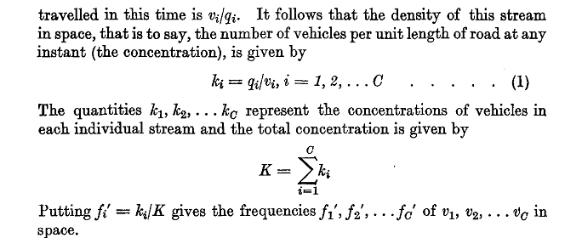
Flow and speed of traffic
Distributon of Speed in Space

Slide 6
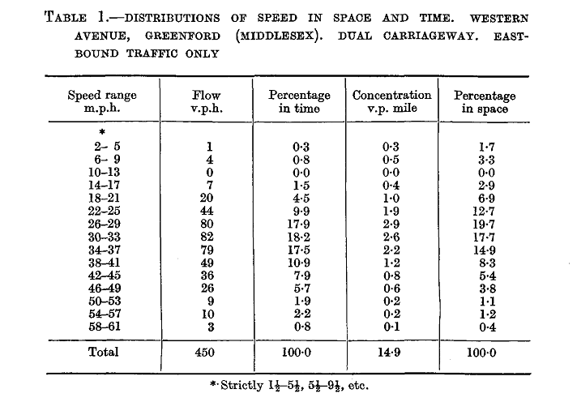

Slide 7
Flow and speed of traffic
Mean Speeds

Slide 8
Flow and speed of traffic
Mean Speeds

Slide 9
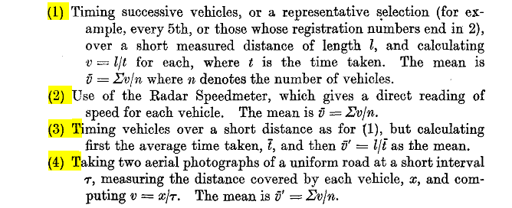
Flow and speed of traffic
Mean Speeds

Slide 10
Flow and speed of traffic
Mean Speeds

Slide 11
Flow and speed of traffic

Slide 12
FREQUENCY OF OVERTAKING

Slide 13
CAPACITY OF ROAD SYSTEM

Slide 14
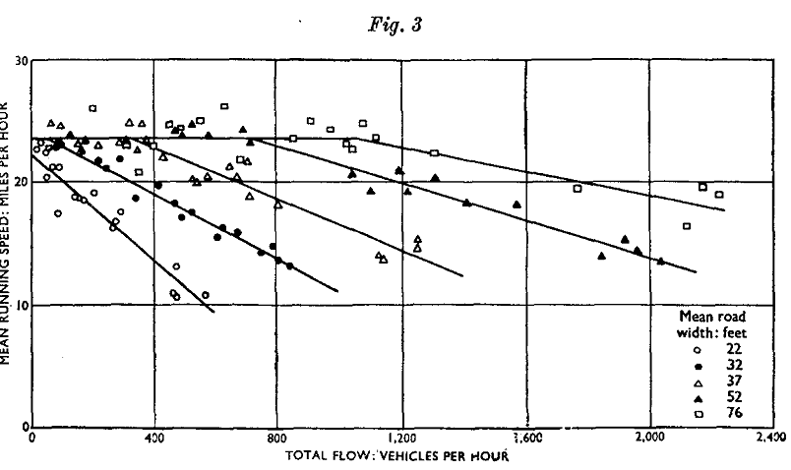
CAPACITY OF ROAD SYSTEM

Slide 15
FREQUENCY OF OVERTAKING

Slide 16
CAPACITY OF ROAD SYSTEM

Slide 17
SIGNAL-CONTROLLED INTERSECTIONS

Slide 18
SIGNAL-CONTROLLED INTERSECTIONS
Cycle time
Capacity
delay

Slide 19
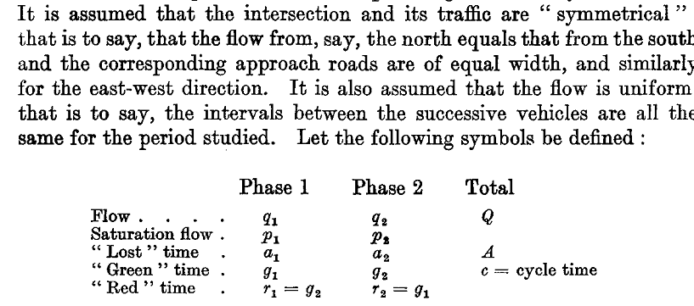
SIGNAL-CONTROLLED INTERSECTIONS
Cycle time
Capacity
delay

Slide 20
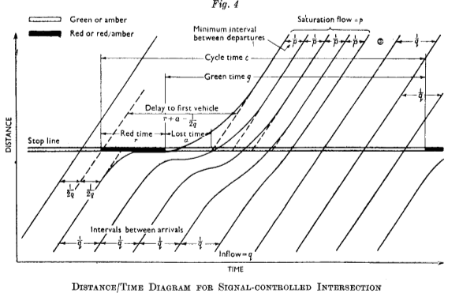
SIGNAL-CONTROLLED INTERSECTIONS

Slide 21
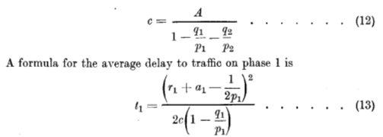
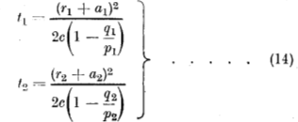
SIGNAL-CONTROLLED INTERSECTIONS

Slide 22
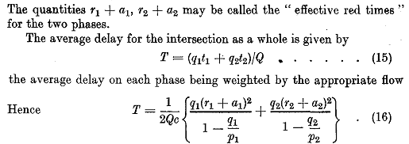
SIGNAL-CONTROLLED INTERSECTIONS

Slide 23
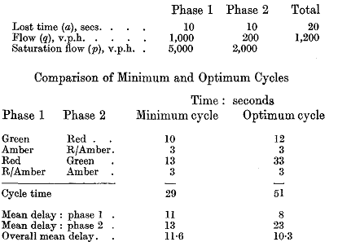
SIGNAL-CONTROLLED INTERSECTIONS

Slide 24
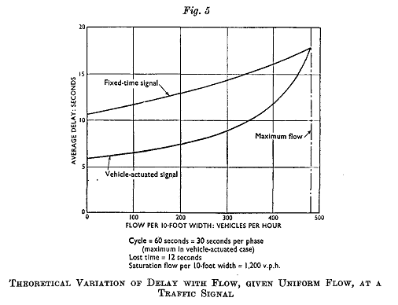
SIGNAL-CONTROLLED INTERSECTIONS

Slide 25
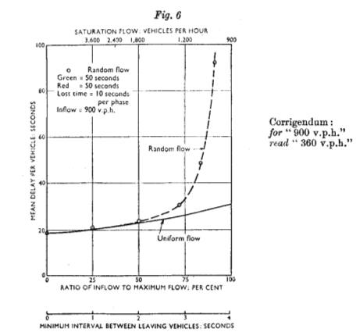
SIGNAL-CONTROLLED INTERSECTIONS

Slide 26
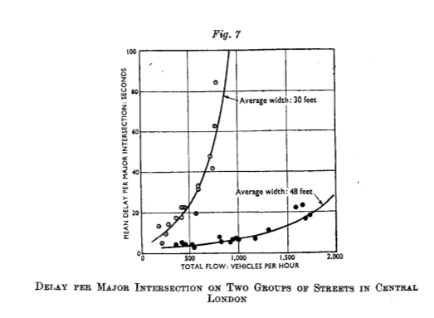
SIGNAL-CONTROLLED INTERSECTIONS

Slide 27
FORMATION OF QUEUES

Slide 28
FORMATION OF QUEUES

