Slide 1
URBAN TRANSPORTATION NERWORKS
FORMULATING THE ASSIGNMENT PROBLEM

Slide 2
OBJECTIVE
Some notations
The basic transformation
Equivalency conditions
Uniqueness conditions
The system – optimization formulation
User equilibrium and System Optimum

Slide 3
1.NOTATIONS
Present some network notations
$N:$ node set
$A$: arc set
$R$: set of origin nodes
$S$: set of destination nodes
$K_{rs}$: set of path connecting O-D pairs $r−s$

Slide 4
$x_{a}$ flow on arc $a$
$x=(…, x_{a}, …)$
$t_{a}$ travel time on arc $a$
$t=\left(…,t_{a},…\right)$
$f_{k}^{rs}$ flow on path $k$ connecting O-D pair $r−s$
$f^{rs}=\left({…,f}_{k}^{rs},….\right);f=(…, f^{rs}, …)$

Slide 5
$c_{k}^{rs}$ travel time on path $k$ connecting O-D pair $r−s$
$c^{rs}=\left(…,c_{k}^{rs},….\right);c=(…,c^{rs}, …)$
$q_{rs}$ trip rate between O-D pair $r−s$
$q=(…,q^{rs}, …)$
$δ_{a,k}^{rs}$ indicator variable
$δ_{a,k}^{rs}=\left\{\begin{aligned}1: arc a on path k between r−s \\ 0:otherwise \\ \end{aligned}\right.$
${{{(∆}_{}^{rs})}_{a,k }}^{}=δ_{a,k}^{rs}; ∆=({{…,(∆}_{}^{rs})}_{a,k },…)$

Slide 6
RELATIONS
Path-arc incidence relationship
Travel time on path and travel time on link
$$c_{k}^{rs}=\sum_{a}{t_{a}δ_{a,k}^{rs} (1.1a) }$$
Link flow and path flow
$$x_{a}=\sum_{r,s,k}{f_{k}^{rs}δ_{a,k}^{rs}} (1.1.b)$$

Slide 7
In the matrix form:
$c=t∆ and x=f∆^{T}$

Slide 8
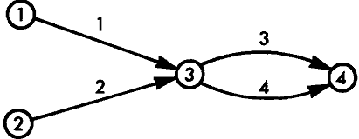
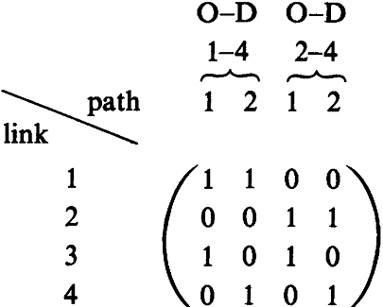
Example

Slide 9
Assume: from $1$ to $4$: the first path $(1,3)$
the second path $(1,4)$
from $2$ to $4$: the first path $(2,3)$
the second path $(2,4)$
The path-arc incidence relationships
$c_{1}^{14}=t_{1}δ_{1,1}^{14}+t_{2}δ_{2,1}^{14}+t_{3}δ_{3,1}^{14}$+$t_{4}δ_{4,1}^{14}=t_{1}+t_{2}$
$x_{3}=f_{1}^{14}δ_{3,1}^{14}+f_{2}^{14}δ_{3,2}^{14}$+$f_{1}^{24}δ_{3,1}^{24}$+$f_{2}^{24}δ_{3,2}^{24}$
$=f_{1}^{14}+f_{1}^{24}$

Slide 10
2.THE BASIC TRANSFORMATION
Mathematical program: (Beck-mann’s transformation)
Min $z\left(x\right)=\sum_{a}{\int_{0}^{x_{a}}{t_{a}(ω)}}dω (2.1a)$
(The meaning of this objective function?)
Subject to
${\sum{f_{k}^{rs}=q}}_{rs} ∀r,s$ (2.1b)
$f_{k}^{rs}≥0 ∀k,r,s (2.1c)$
$x_{a}=\sum_{r,s,k}{f_{k}^{rs}δ_{a,k}^{rs}} ∀a$ (2.1c)

Slide 11
Some assumptions
$$\frac{∂t_{a}(x_{a})}{∂x_{a}}>0 ∀a (2.2a)$$
$$\frac{∂t_{a}(x_{a})}{∂x_{b}}=0 ∀a≠b (2.2b)$$

Slide 12
EXAMPLE
$$t_{1}=2+x_{1};t_{2}=1+2x_{2}$$
$$Trip rate q=5⇒x_{1}+x_{2}=5$$
UE condition: $t_{1}=t_{2}⇒x_{1}=3 and{ x}_{2}=2\left(flow units\right),t_{1}=t_{2}=5(time units)$

Slide 13
Use program $(2.1)$:
$\min{z\left(x\right)=\int_{0}^{x_{1}}{\left(2+ω\right)dω+\int_{0}^{x_{1}}{\left(1+2ω\right)dω}}}$
Subject to
$x_{1}+x_{2}=5$
${ x}_{1},x_{2}≥0$
Solution:
$x_{1}=3 \& x_{2}=2;t_{1}=t_{2}=5$

Slide 14
3.EQUIVALENCE CONDITIONS

Slide 15
SOLVE PROGRAM (2.1)
Consider Lagrange’s function:
$$L\left(f,u\right)=z\left(x\left(f\right)\right)+\sum_{r,s}{u_{rs}(q_{rs}−\sum_{k}{f_{k}^{rs}})} \left(3.1a\right)$$
$$f_{k}^{rs}≥0∀ k,r,s (3.1b)$$
The first-order condition:
$f_{k}^{rs}\frac{∂L(f,u)}{∂f_{k}^{rs}}=0;\frac{∂L(f,u)}{∂f_{k}^{rs}}≥0 ∀ k,r,s (3.2a)$
$\frac{∂L(f,u)}{∂u_{rs}}=0∀ r,s (3.2b)$

Slide 16
The general first conditions $(3.2a)$
$$f_{k}^{rs}\left(c_{k}^{rs}−u_{rs}\right)=0 ∀ k, r, s \left(3.3a\right)$$
$$c_{k}^{rs}−u_{rs}=0 ∀ k, r, s (3.3b)$$
$$\sum_{k}{f_{k}^{rs}=q_{rs} ∀ r, s (3.3c)}$$
$$f_{k}^{rs}≥0 ∀ k, r, s (3.3d)$$

Slide 17
RELATED TO U-E PROBLEM
From $\left(3.3a\right) \& (3.3b)$:
$$c_{k}^{rs}=u_{rs}=\min_{k}{c_{k}^{rs}} ∀ k s.t:f_{k}^{rs}>0$$
$⇒$ state the U-E principle

Slide 18
4. UNIQUENESS CONDITIONS
Prove that: problem $\left(2.1\right)$ have unique solution w.r.t link flow$:$
Objective function$(2.1a)$ is strictly convex w.r.t $x$
Feasible region $\left(2.1b\right)\&\left(2.1c\right)$ is convex
Hessian matrix is positive define:
$∇^{2}z\left(x\right)=diag(\frac{dt_{1}\left(x_{1}\right)}{dx_{1}},\frac{dt_{1}\left(x_{2}\right)}{dx_{2}},…,\frac{dt_{1}\left(x_{n}\right)}{dx_{n}})$

Slide 19
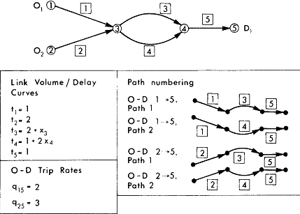
EXAMPLE

Slide 20
Equilibrium link flow:
$x_{1}=2,x_{2}=3, x_{3}=3, x_{4}=2,x_{5}=5$
Equilibrium path flow (use $(1.1b)$)
$f_{1}^{15}=2α,f_{2}^{15}=2\left(1−α\right)$
$$f_{1}^{25}=3−2α,f_{2}^{25}=2α$$
$$\left(0≤α≤1\right)$$

Slide 21
$⇒$Program $(2.1)$ has not unique solution w.r.t path flow $f.$
Reason?

Slide 22
5. THE SYSTEM- OPTIMIZATION FORMULATION
Program:
$\min{\tilde{z} (x)}=\sum_{a}{t_{a}x_{a}(t_{a})} \left(5.1a\right)$
(The meaning of objective function?)
Subject to
${\sum_{a}{f_{k}^{rs}=q}}_{rs} ∀r,s$ (5.1b)
$$f_{k}^{rs}≥0 ∀k,r,s (5.1c)$$
$x_{a}=\sum_{r,s,k}{f_{k}^{rs}δ_{a,k}^{rs}} ∀a$ (5.1c)

Slide 23
Characteristic:
Solution of S-O problem does not present equilibrium situation.
At S-O situation, divers can decrease their travel time by unilaterally changing routes

Slide 24
SOLVE S-O PROGRAM
Equivalency conditions:
$${\tilde{f}}_{k}^{rs}\left({\tilde{c}}_{k}^{rs}−{\tilde{u}}_{rs}\right)=0 ∀ k, r, s \left(5.2a\right)$$
$${\tilde{c}}_{k}^{rs}−{\tilde{u}}_{rs}=0 ∀ k, r, s (5.2b)$$
$$\sum_{k}{{\tilde{f}}_{k}^{rs}=q_{rs} ∀ r, s (5.2c)}$$
$${\tilde{f}}_{k}^{rs}≥0 ∀ k, r, s (5.2d)$$
Where:${\tilde{t}}_{a}=t_{a}\left(x_{a}\right)+\frac{dt_{a}(x_{a})}{dx_{a}}$

Slide 25
6. USER EQUILIBRIUM & SYSTEM OPTIMUM

Slide 26
SPECIAL CASE
Congestion is ignored: $\left(t_{a}\left(x_{a}\right)=c_{a}=const ∀a\right)⇒$ SO$≡$UE
General case:$min\tilde{z}\left(x\right)>minz(x)$

Slide 27
UE solution can be obtain by solve SO problem
$${\hat{t}}_{a}\left(x_{a}\right)=\frac{1}{x_{a}}\int_{o}^{x_{a}}{t_{a}\left(ω\right)dω}$$
And vice versa.

Slide 28
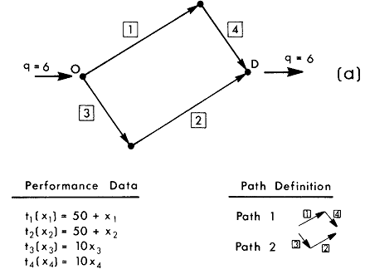
BRAESS’S PARADOX

Slide 29
U-E solution:
$f_{1}=f_{2}=3$ (flow units)
$x_{1}=x_{2}=x_{3}=x_{4}=3$ (flow units)
$t_{1}=t_{2}=53, t_{3}=t_{4}=30$(time units)
Total travel time: $498$ (flow units)

Slide 30
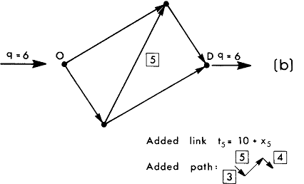
Adding a new path to improve flow

Slide 31
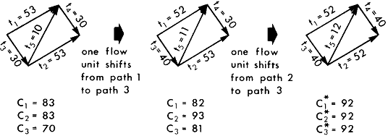
UE solution:
$x_{1}=x_{2}={2,x}_{3}=x_{4}=4, x_{5}=2$(flow units)
$f_{1}=f_{2}=f_{3}=2$ (flow units)
$c_{1}=c_{2}=c_{3}=92$ (time units)
Total travel time: $552$(time units)

Slide 32
Compare
Total travel time $552>498$
Travel time by each traveller in network: $92>83$
Explain:
Rooted in the property of the UE
Individual choice of routes effects on other networks users.
Mathematically:
UE objective function decrease: $399→386$

Slide 33
THANK YOU

